Slide 1

TEAM - HASHTAG
Presents
Order On Time(OoT)
(Customers preference our priority)
“Hospitality”

Slide 2

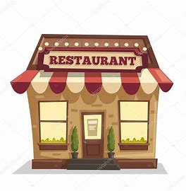
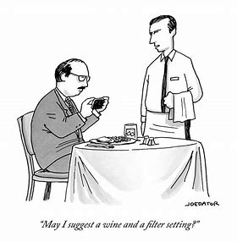

Traditional working culture
Sometimes customers behave very rudely with the staff of the restaurant and as they are our customer, we can’t disrespect them but it effects the work spirit of the employee
Why don’t we try to transfer verbal conversation to the non verbal one using digitalization?
How?
Let’s Learn
Sometimes the interaction bet. the customer is good and respectful, we respect those customers
To avoid this kind of situation we our planning to introduce a plan where both parties get satisfy

Slide 3
Problem Statement
In today's world one of the major problems the restaurants are facing is how to maintain a good relationship with the customers. Most of the time employees complain about the rude behavior of the customers which leads to the dissatisfaction during work and sometimes customer also downgrade the restaurant ratings.

Slide 4
Solution
For resolving this problem, we are providing a feature "OOT" (a digital menu) which will collect the orders digitally and the waiter(employee) just need to deliver the order to the table of the customer.
The order will be collected on First Come First Serve basis and the order number will be provided to the customer to avoid any type of conflict.
In case a customer is not satisfied, they can simply leave their review and feedback on the portal. The system will collect those reviews and generate a live report for each dish in menu seperately so that restaurant can improve their services.
.

Slide 5

IDEA
1
To reduce the conflict between the employee and the customer by focussing more on non verbal communication rather than verbal
2
The data analysis for a particular food item will be provided on the basis of the ratings calculated based on that particular dish.

9
3
Providing digital menu card so that people can order even before reaching the place to save time and provide their reveiws which will be only available to the restaurant staff so that they can improve.

Slide 6

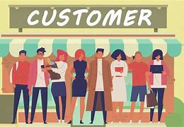
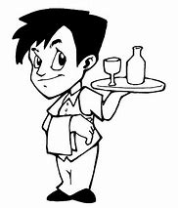
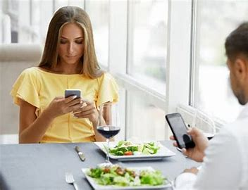
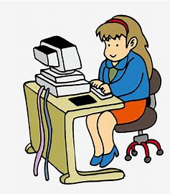
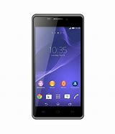

Use Case
When customer order using digital menu (OOT), waiter will serve it
Features
Restaurant staff receive order and after customer’s check-in, it is served to them
Options In OOT (digital menu)
Order using OOT
Will receive order no. based on priority
Option to use symbols to provide ratings to the restaurant
Option to leave the reviews for the restaurant
Static report for each dish in menu separately
Order details
Details of user preference and other important info. will be stored in it

Slide 7
Business Impact
Today when hospitality is the major concern, its getting more and more important to maintain the good relationship with the customers.
By providing this our customers can maintain good relationship with their customers which will ultimately leads to the good business relationships between NCR and the restaurant branches.
As NCR we always follow the motto of customer is our first priority, so by introducing our feature we can left a great impact on our customers.

Slide 8
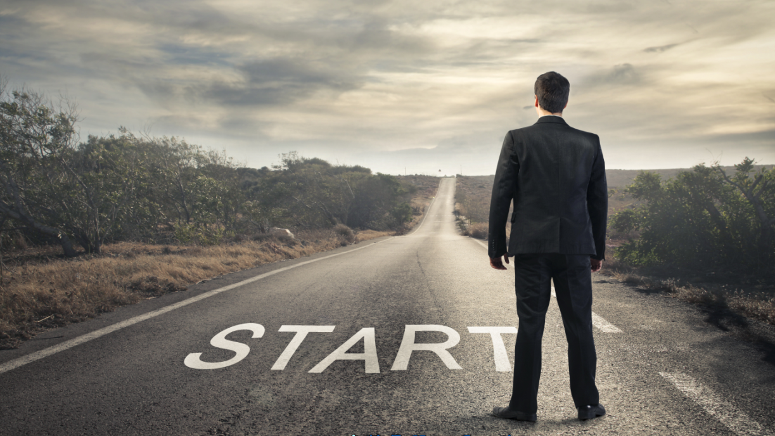
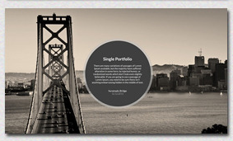
By implementing this idea we can improve the customer- restaurent relatioships which will automatically leads to two benefits first customer can express themselve without any argument and second staffis can avoid to deal with any rude customer without offending them

Slide 9
THANK YOU

